Slide 1
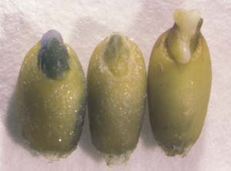
Vacuum & Electroporation Methodology - Effectiveness
Effectiveness
VE
E
--
N: Negative control, --: Buffer only, V: Vacuum, E: Electroporation
Fig. 4: GUS gene expression reference (Wheat)
Fig.3: The level of GUS gene expression by fluorescence assay (Wheat)
(6/24)

