Slide 1
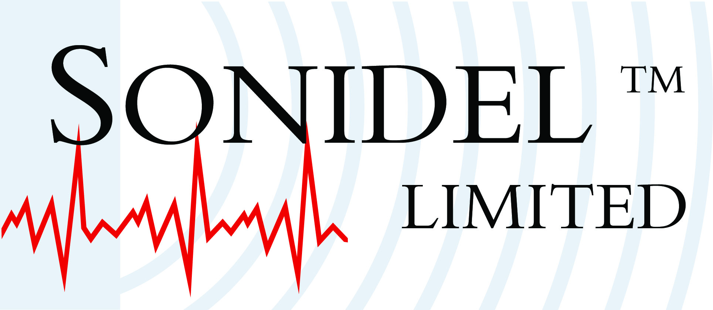
Vacuum and Electroporation Method Advantages
New Vacuum & Electroporation Method Advantages
National Institute of Agrobiological Sciences Japan – patents pending*
Plant : No Need for Tissue Culture. No Particular Know-how or skill required. Large reduction in handling an labour. Starting materials are mature seeds. Transformed plants are obtained in relatively short time
Animal (silk worm) : No Need Microinjection
Simple
Efficient
Low-cost
*”Electroporation method including the use of depressurization / presurization” PCT/JP03/08937
(3/24)

