Slide 1
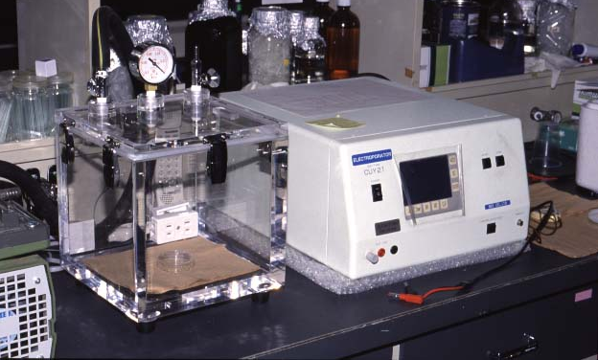
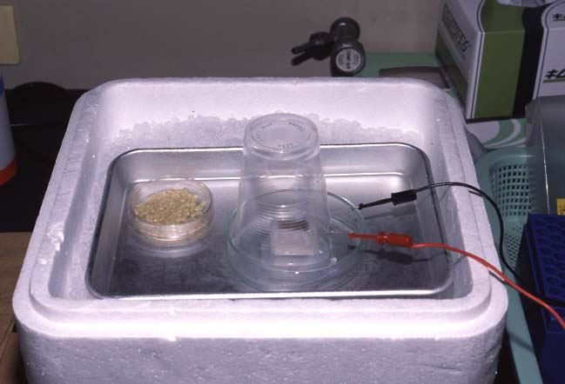
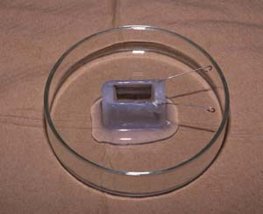
Vacuum & Electroporation Method - Apparatus Required
Fig.1: Vacuum Chamber (left) and Electroporator,
CUY21EDIT(right)
Fig.2: Chamber Having Platinum Electrode, CUY495P10
(5/24)

