Slide 1
Polarized collective cell movements drive antero-posterior folding to form the avian hindgut
Nandan Nerurkar
Tabin Lab

Slide 2
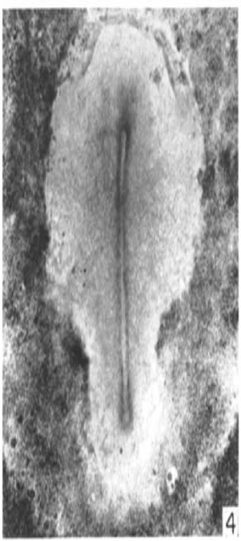
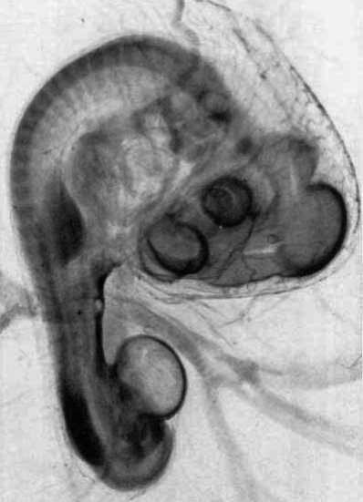
Morphogenesis of the gut tube
18 hours (HH 4)
72 hours
(HH 20)
ECTODERM
MESODERM
ENDODERM

Slide 3
NEPA21 Electroporation parameters
Poring pulse: 40V, 3 pulses, 0.1 ms duration, 50 ms pause, 10% decay (no polarity)
Transfer pulse: 4V, 5 pulse, 5 ms duration, 50 ms pause, 40% decay (no polarity)
DNA: 5ug/uL in 5% sucrose PBS
Impedance ~0.5-0.55 kOhm
Viability 70-80%, Efficiency 50-70%
BTX830: Viability 3%, Efficiency 20-80%

Slide 4
Electroporation of the chick endoderm
HH18 (72 hours)
pCAG-GFP

Slide 5
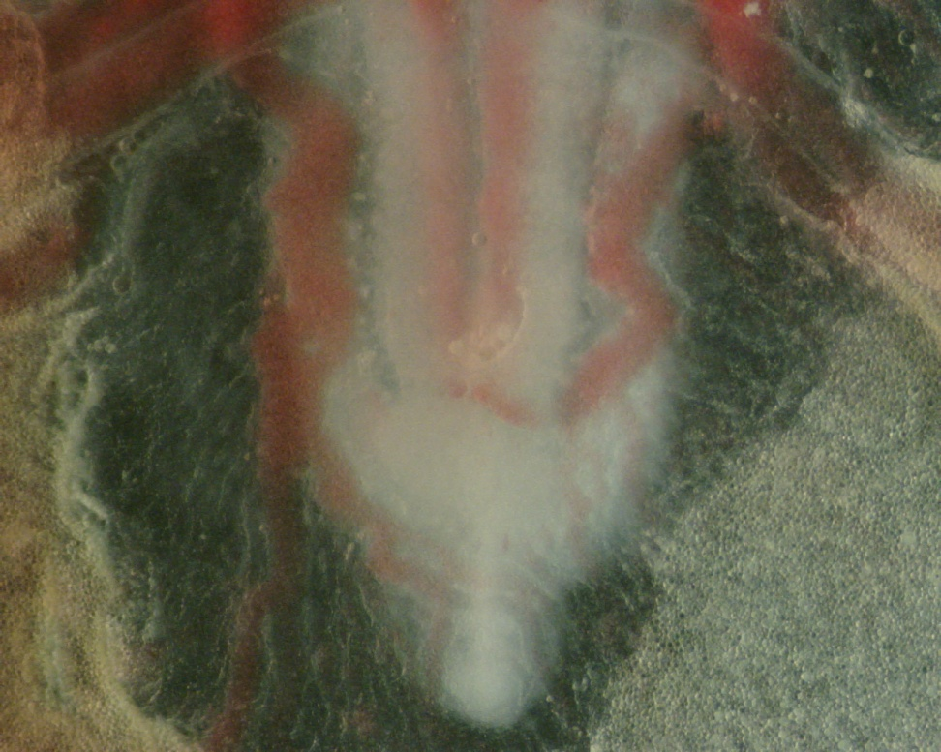
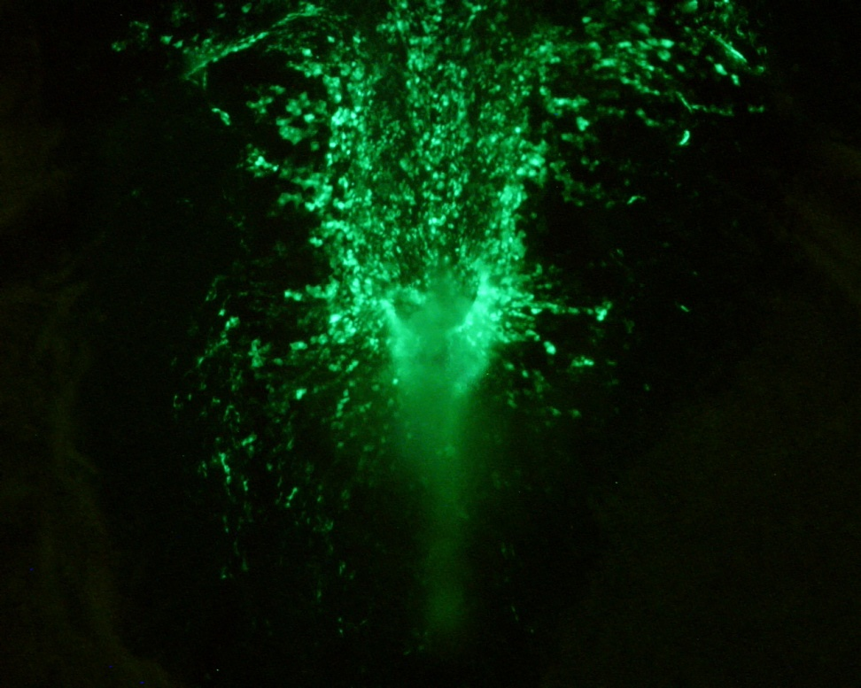
Electroporation of the chick endoderm
CIP
CIP
Hindgut
Tail bud

Slide 6
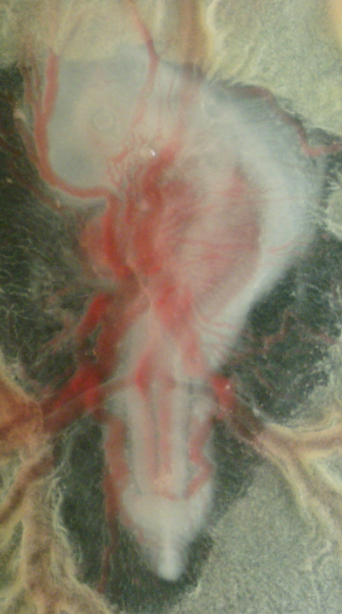
Cross sections through the hindgut following pCAG-GFP electroporation into the endoderm
1
2
3
1
2
3

Slide 7
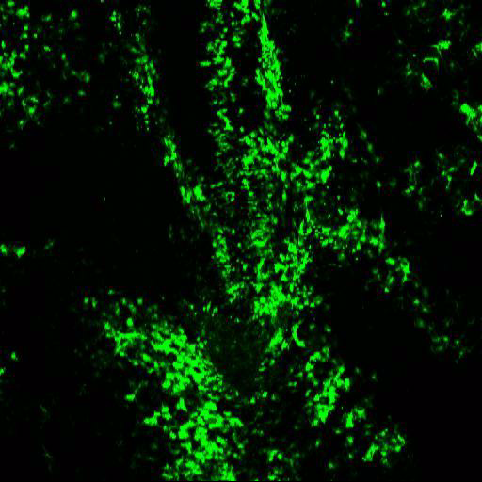
Cells flow posteriorly during hindgut formation
8 hr (HH14 to HH17)
pCAG-GFP

Slide 8
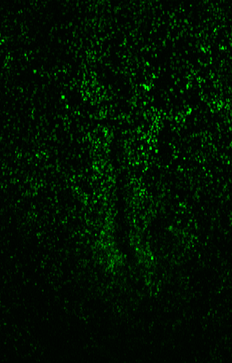
pCAG-H2B:GFP
8 hours (HH13-HH)14
time

