Slide 1
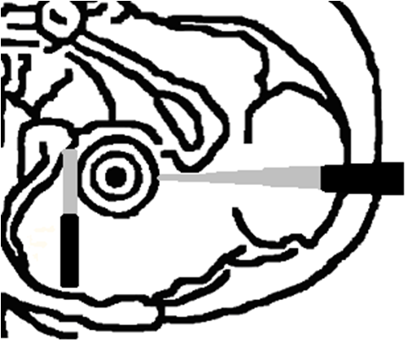
Chick Embryo: Retina EP
Positive Electrode
Negative Electrode
Negative Electrode
CUY614 & CUY615
DNA
Insulated by nail polish
Positive Electrode
CUY611P3

